Slide 1

Our Trinity Relationship
Isaiah 6:1–8; Romans 8:12–17; John 3:1–17

Slide 2
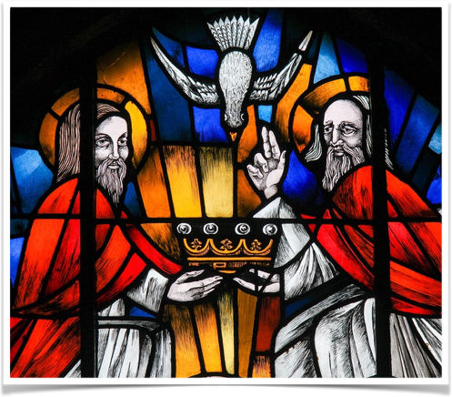
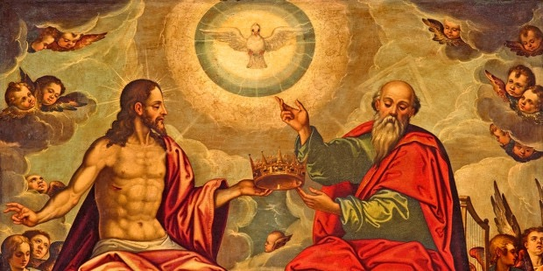
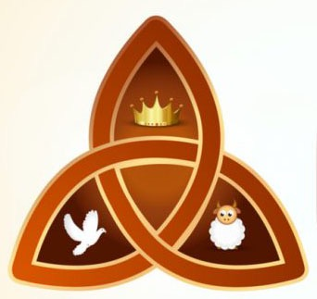
Isaiah

Slide 3
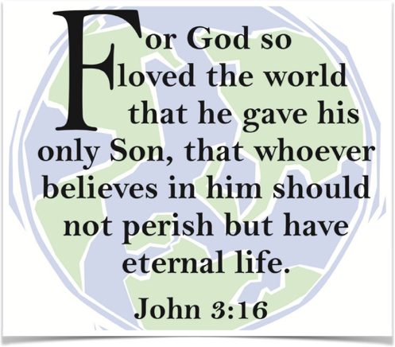

John

Slide 4
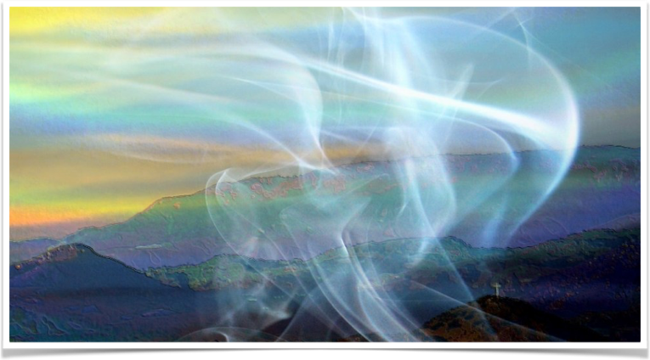
Romans

Slide 5
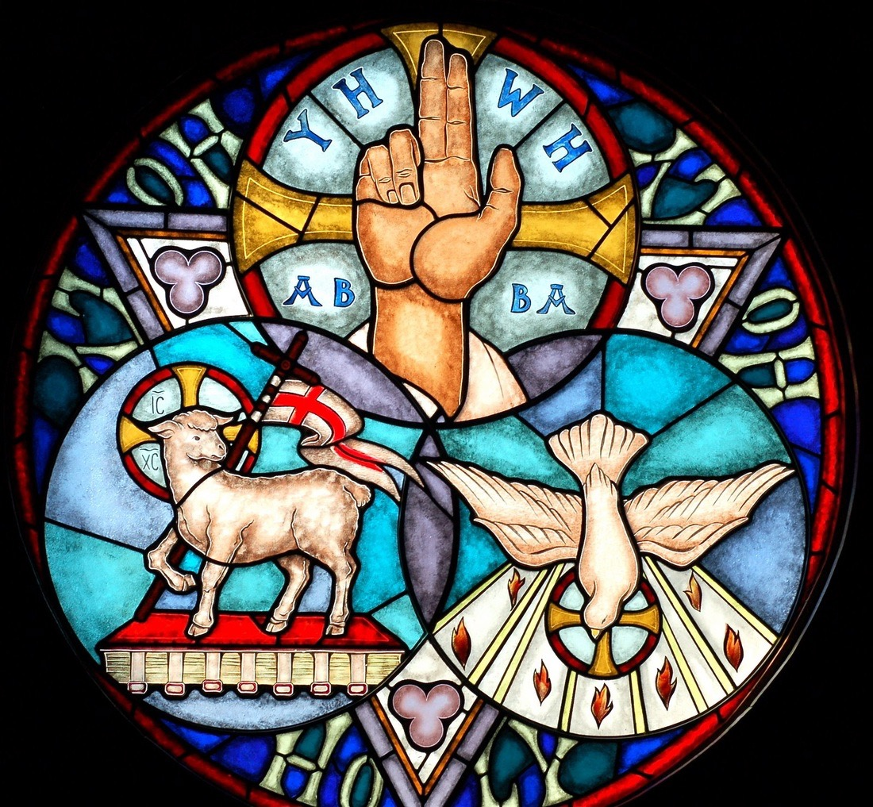

Slide 6
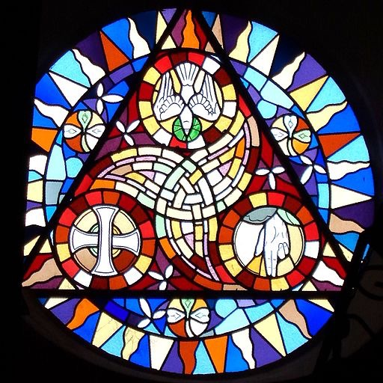

Slide 7
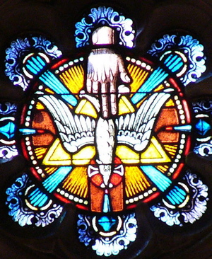

Slide 8
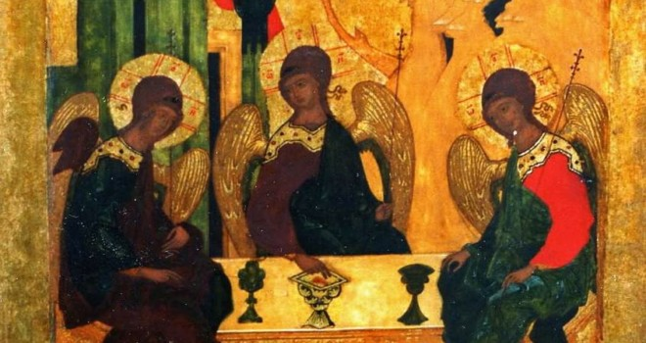

Slide 9
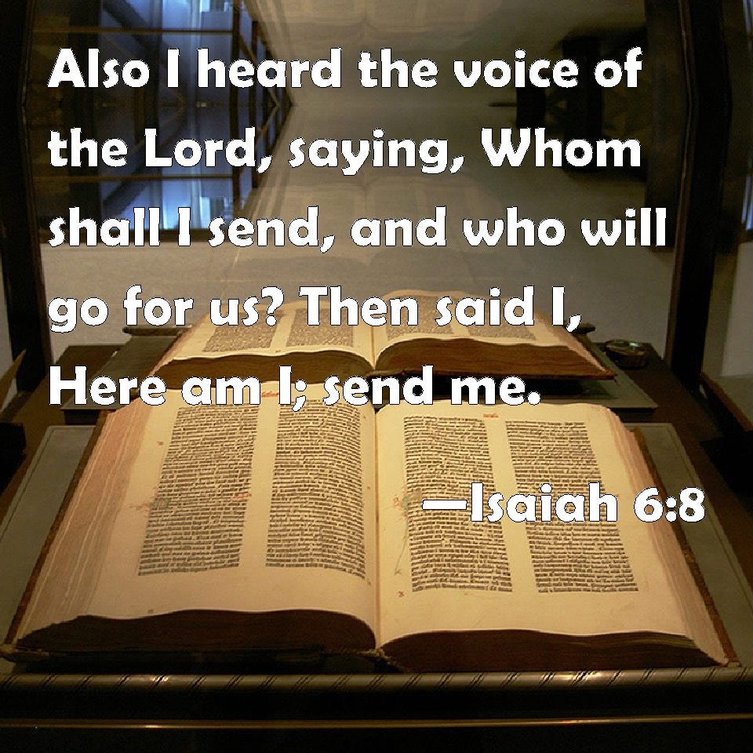

Slide 10
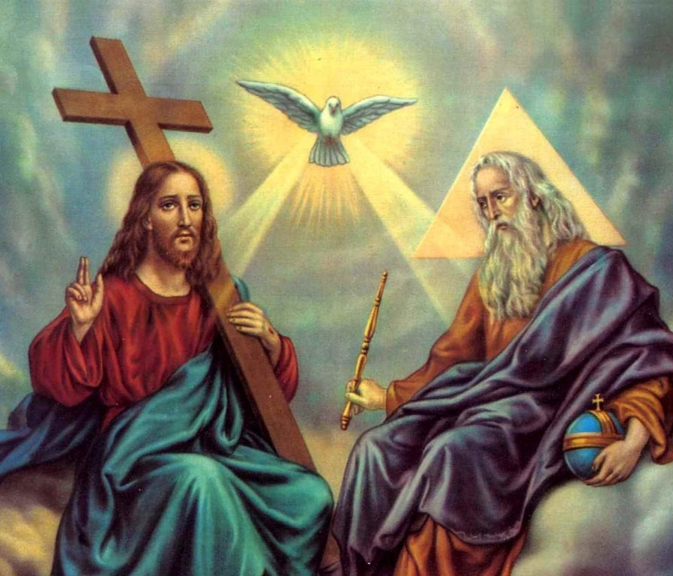

Slide 11
I believe in God,
the Father Almighty

Slide 12
I believe in Jesus
Christ, his only Son

Slide 13
I believe in
the Holy Spirit

Slide 14
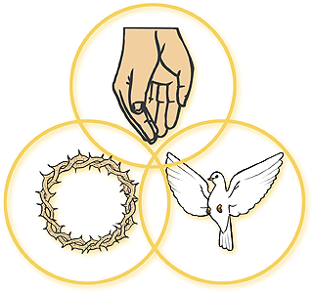
Nicene Creed: #880
“Of the Father’s love begotten, ere the worlds began to be…”

Slide 15


Slide 16
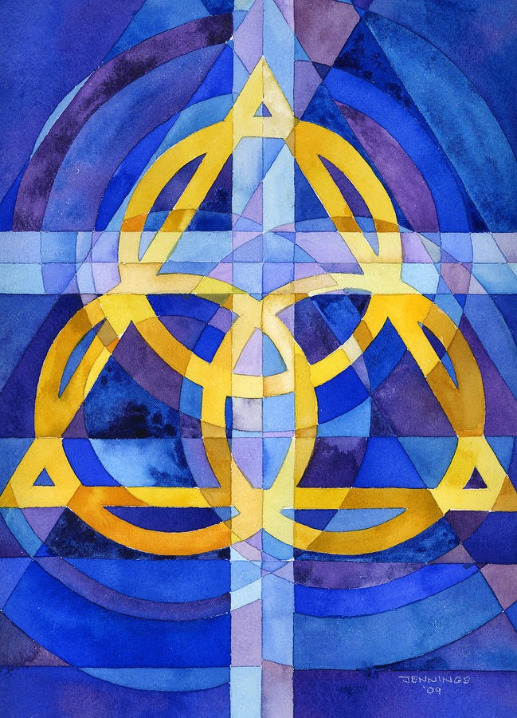

Slide 17
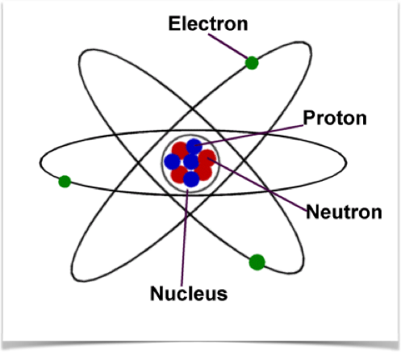
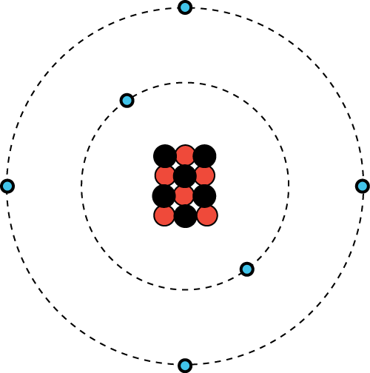
Atom Analogy

Slide 18

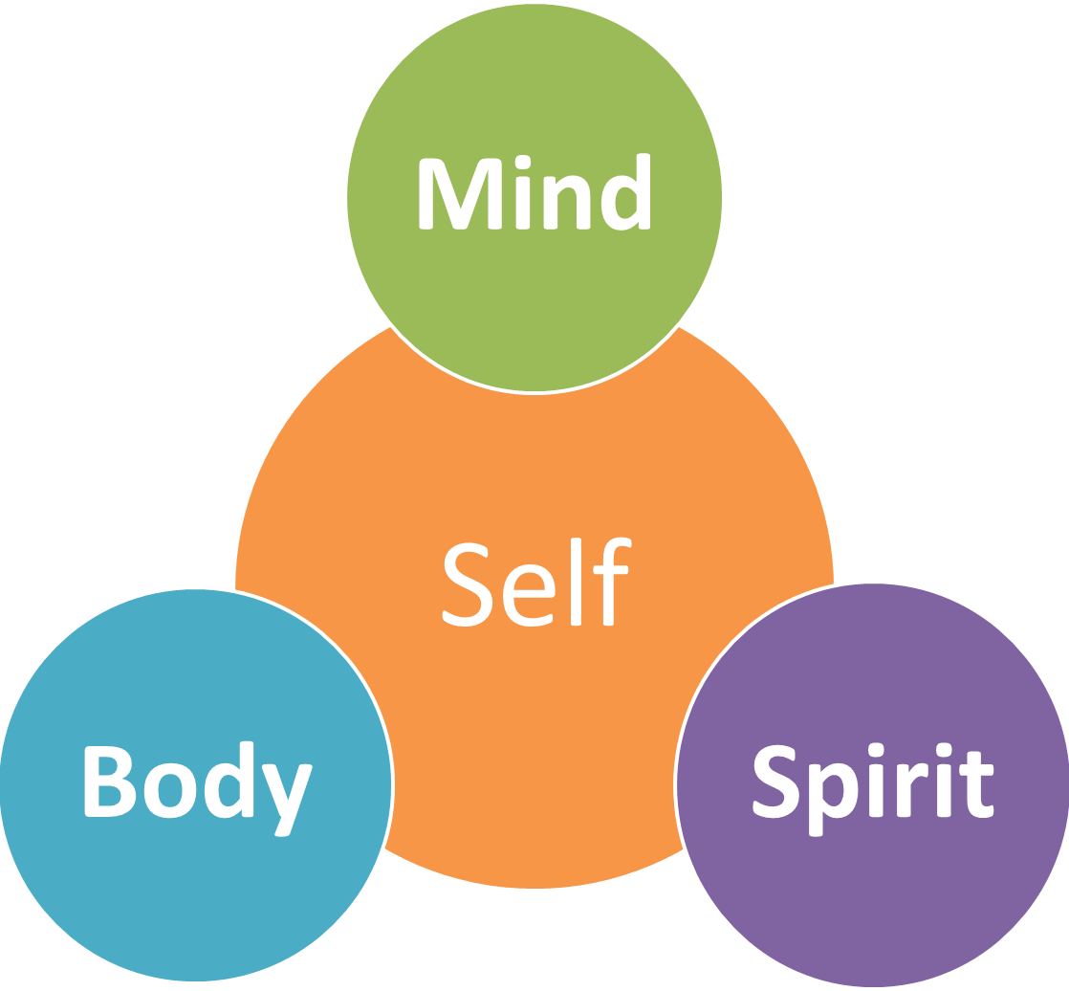
Human Analogy

Slide 19




Slide 20
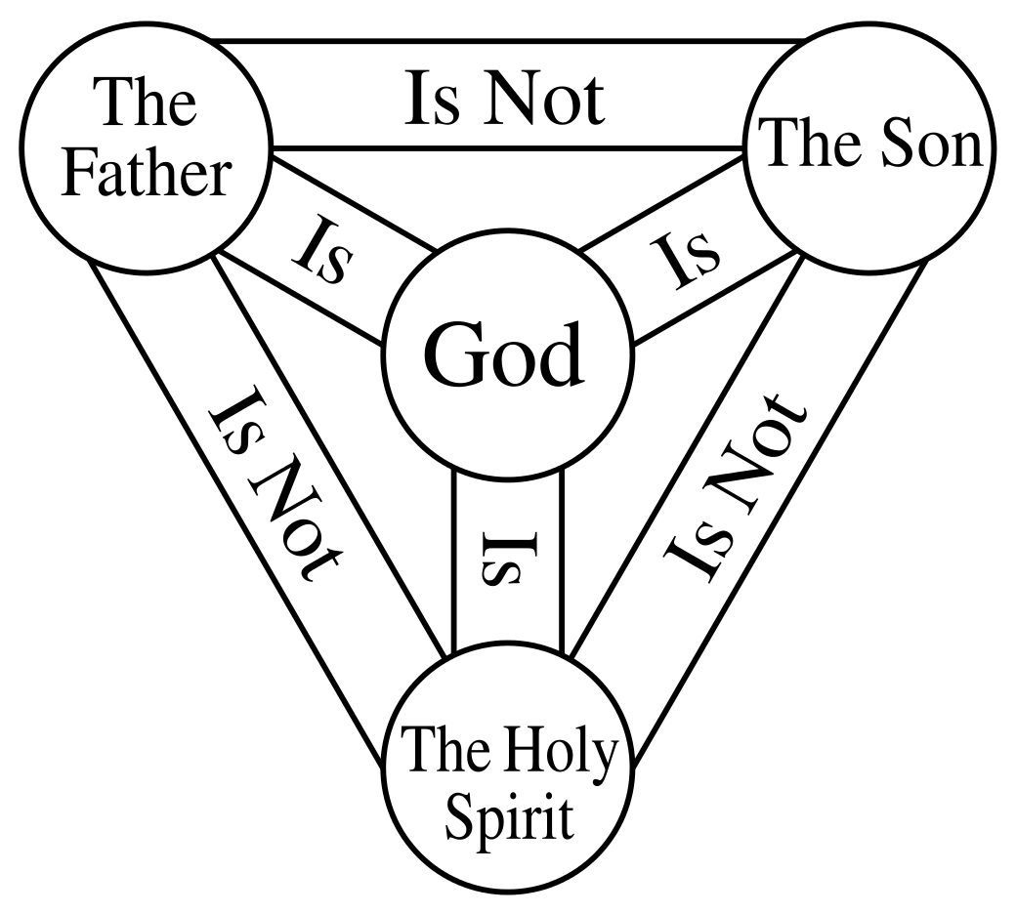

Slide 21
Nicene Creed: #880
“Of the Father’s love begotten, ere the worlds began to be…
Christ, to thee with God the Father, and, O Holy Ghost, to thee,
hymn and chant and high thanksgiving, and unwearied praises be…”

Slide 22
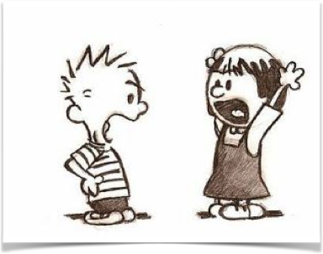

Be a Person vs.
Be an Individual
“One cannot really be a person except in community.”

Slide 23
I believe in the holy Spirit,
the holy catholic church,
the communion of saints,
the forgiveness of sins,
the resurrection of the body
and the life everlasting

Slide 24


Slide 25
Our Trinity Relationship
Isaiah 6:1–8; Romans 8:12–17; John 3:1–17

